Slide 1
Digital Design & Computer Arch. Lecture 19: SIMD Processors
Prof. Onur Mutlu
ETH Zürich
Spring 2020
7 May 2020

Slide 2
We Are Almost Done With This…
Single-cycle Microarchitectures
Multi-cycle Microarchitectures
Pipelining
Issues in Pipelining: Control & Data Dependence Handling, State Maintenance and Recovery, …
Out-of-Order Execution
Other Execution Paradigms

Slide 3
Approaches to (Instruction-Level) Concurrency
Pipelining
Out-of-order execution
Dataflow (at the ISA level)
Superscalar Execution
VLIW
Systolic Arrays
Decoupled Access Execute
Fine-Grained Multithreading
SIMD Processing (Vector and array processors, GPUs)

Slide 4
Readings for this Week
Required
Lindholm et al., "NVIDIA Tesla: A Unified Graphics and Computing Architecture," IEEE Micro 2008.
Recommended
Peleg and Weiser, “MMX Technology Extension to the Intel Architecture,” IEEE Micro 1996.

Slide 5
Announcement
Late submission of lab reports in Moodle
Open until June 20, 2020, 11:59pm (cutoff date -- hard deadline)
You can submit any past lab report, which you have not submitted before its deadline
It is NOT allowed to re-submit anything (lab reports, extra assignments, etc.) that you had already submitted via other Moodle assignments
We will grade your reports, but late submission has a penalization of 1 point, that is, the highest possible score per lab report will be 2 points

Slide 6
Exploiting Data Parallelism: SIMD Processors and GPUs

Slide 7
SIMD Processing: Exploiting Regular (Data) Parallelism

Slide 8
Flynn’s Taxonomy of Computers
Mike Flynn, “Very High-Speed Computing Systems,” Proc. of IEEE, 1966
SISD: Single instruction operates on single data element
SIMD: Single instruction operates on multiple data elements
Array processor
Vector processor
MISD: Multiple instructions operate on single data element
Closest form: systolic array processor, streaming processor
MIMD: Multiple instructions operate on multiple data elements (multiple instruction streams)
Multiprocessor
Multithreaded processor

Slide 9
Data Parallelism
Concurrency arises from performing the same operation on different pieces of data
Single instruction multiple data (SIMD)
E.g., dot product of two vectors
Contrast with data flow
Concurrency arises from executing different operations in parallel (in a data driven manner)
Contrast with thread (“control”) parallelism
Concurrency arises from executing different threads of control in parallel
SIMD exploits operation-level parallelism on different data
Same operation concurrently applied to different pieces of data
A form of ILP where instruction happens to be the same across data

Slide 10
SIMD Processing
Single instruction operates on multiple data elements
In time or in space
Multiple processing elements
Time-space duality
Array processor: Instruction operates on multiple data elements at the same time using different spaces
Vector processor: Instruction operates on multiple data elements in consecutive time steps using the same space

Slide 11
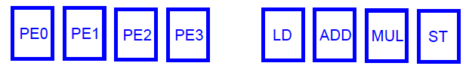
Array vs. Vector Processors
ARRAY PROCESSOR
VECTOR PROCESSOR
Instruction Stream
Same op @ same time
LD VR ← A[3:0]
ADD VR ← VR, 1
MUL VR ← VR, 2
ST A[3:0] ← VR
Different ops @ time
LD0
LD1
LD2
LD3
LD0
AD0
AD1
AD2
AD3
LD1
AD0
MU0
MU1
MU2
MU3
LD2
AD1
MU0
ST0
ST1
ST2
ST3
LD3
AD2
MU1
ST0
Different ops @ same space
AD3
MU2
ST1
MU3
ST2
Time
Same op @ space
ST3
Space
Space

Slide 12
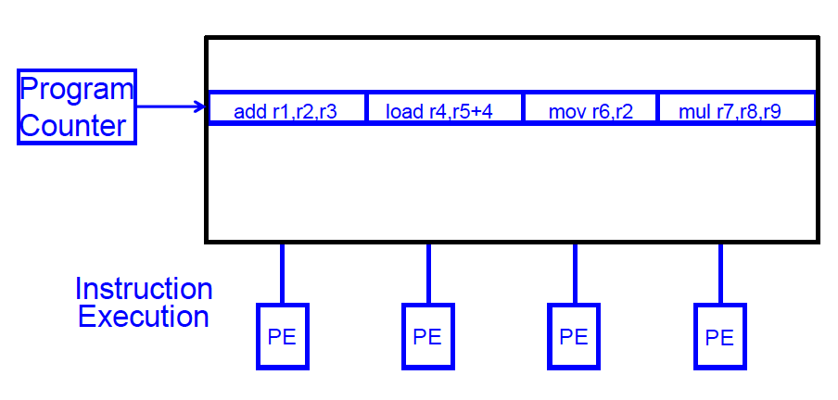
SIMD Array Processing vs. VLIW
VLIW: Multiple independent operations packed together by the compiler

Slide 13
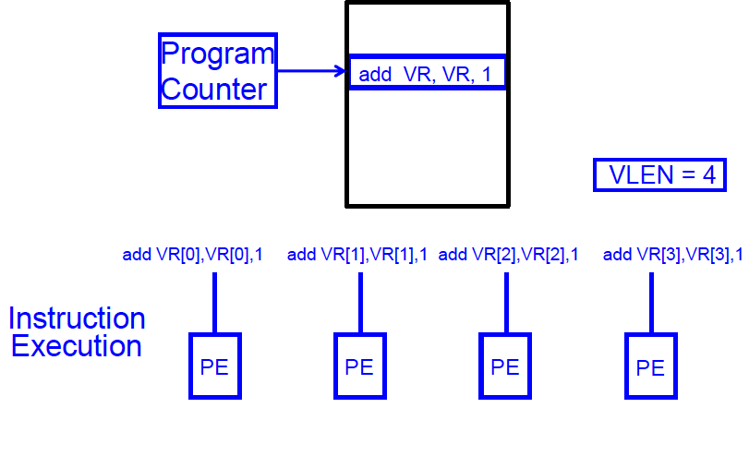
SIMD Array Processing vs. VLIW
Array processor: Single operation on multiple (different) data elements

Slide 14
Vector Processors (I)
A vector is a one-dimensional array of numbers
Many scientific/commercial programs use vectors
for (i = 0; i<=49; i++)
C[i] = (A[i] + B[i]) / 2
A vector processor is one whose instructions operate on vectors rather than scalar (single data) values
Basic requirements
Need to load/store vectors → vector registers (contain vectors)
Need to operate on vectors of different lengths → vector length register (VLEN)
Elements of a vector might be stored apart from each other in memory → vector stride register (VSTR)
Stride: distance in memory between two elements of a vector

Slide 15
Vector Processors (II)
A vector instruction performs an operation on each element in consecutive cycles
Vector functional units are pipelined
Each pipeline stage operates on a different data element
Vector instructions allow deeper pipelines
No intra-vector dependencies → no hardware interlocking needed within a vector
No control flow within a vector
Known stride allows easy address calculation for all vector elements
Enables prefetching of vectors into registers/cache/memory

Slide 16
Vector Processor Advantages
+ No dependencies within a vector
Pipelining & parallelization work really well
Can have very deep pipelines, no dependencies!
+ Each instruction generates a lot of work
Reduces instruction fetch bandwidth requirements
+ Highly regular memory access pattern
+ No need to explicitly code loops
Fewer branches in the instruction sequence

Slide 17
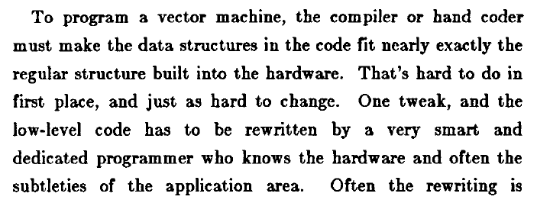
Vector Processor Disadvantages
-- Works (only) if parallelism is regular (data/SIMD parallelism)
++ Vector operations
-- Very inefficient if parallelism is irregular
-- How about searching for a key in a linked list?
Fisher, “Very Long Instruction Word architectures and the ELI-512,” ISCA 1983.

Slide 18
Vector Processor Limitations
-- Memory (bandwidth) can easily become a bottleneck, especially if
1. compute/memory operation balance is not maintained
2. data is not mapped appropriately to memory banks

Slide 19
Vector Processing in More Depth

Slide 20
Vector Registers
Each vector data register holds N M-bit values
Vector control registers: VLEN, VSTR, VMASK
Maximum VLEN can be N
Maximum number of elements stored in a vector register
Vector Mask Register (VMASK)
Indicates which elements of vector to operate on
Set by vector test instructions
e.g., VMASK[i] = (V_{k}[i] == 0)
M-bit wide
M-bit wide
V0,0
V1,0
V0,1
V1,1
V0,N-1
V1,N-1

Slide 21
Vector Functional Units
Use a deep pipeline to execute element operations
→ fast clock cycle
Control of deep pipeline is simple because elements in vector are independent
V1
V2
V3
Six stage multiply pipeline
V1 * V2 → V3
Slide credit: Krste Asanovic

Slide 22
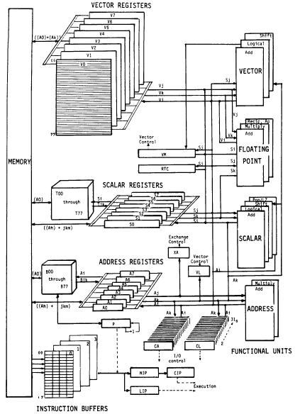
Vector Machine Organization (CRAY-1)
CRAY-1
Russell, “The CRAY-1 computer system,” CACM 1978.
Scalar and vector modes
8 64-element vector registers
64 bits per element
16 memory banks
8 64-bit scalar registers
8 24-bit address registers

Slide 23
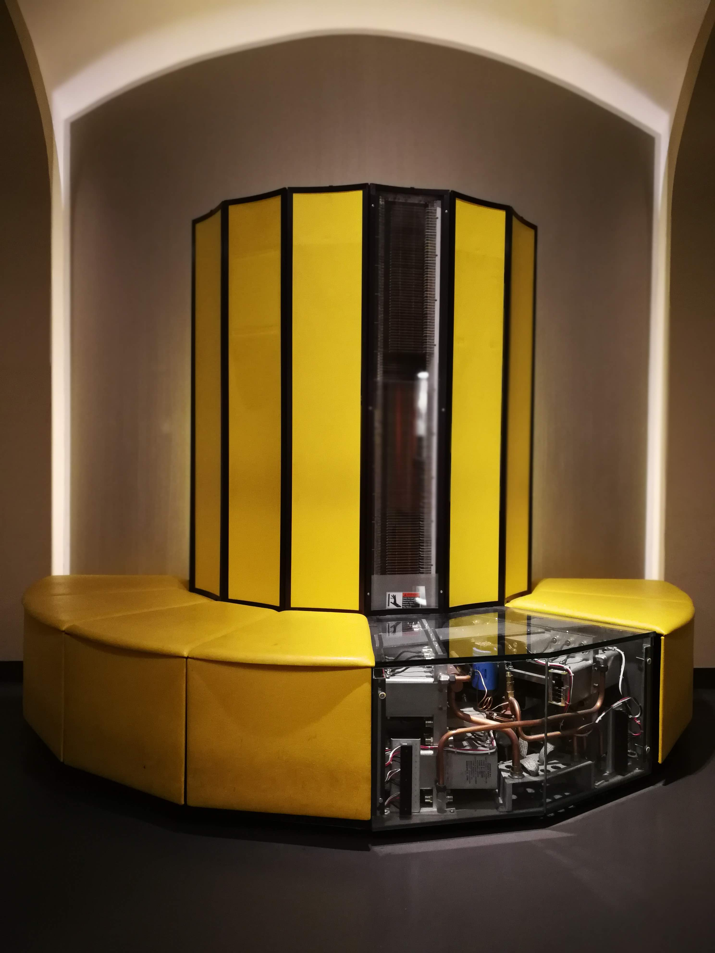
CRAY X-MP-28 @ ETH (CAB, E Floor)

Slide 24
CRAY X-MP System Organization
Cray Research Inc., “The CRAY X-MP Series of Computer Systems,” 1985

Slide 25
CRAY X-MP Design Detail
Cray Research Inc., “The CRAY X-MP Series of Computer Systems,” 1985

Slide 26
CRAY X-MP CPU Functional Units
Cray Research Inc., “The CRAY X-MP Series of Computer Systems,” 1985

Slide 27
CRAY X-MP System Configuration
Cray Research Inc., “The CRAY X-MP Series of Computer Systems,” 1985

Slide 28
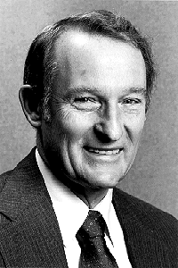
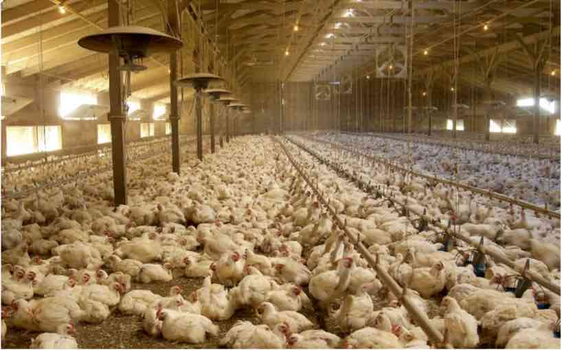
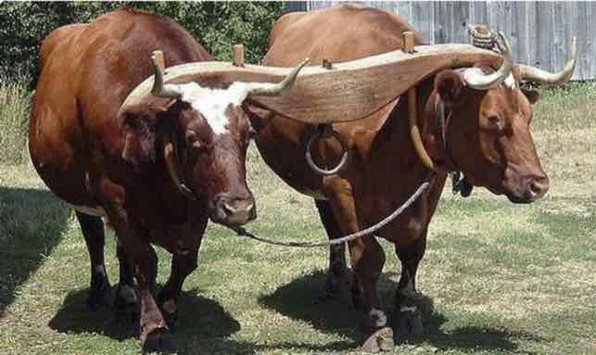
Seymour Cray, the Father of Supercomputers
"If you were plowing a field, which would you rather use: Two strong oxen or 1024 chickens?"
© amityrebecca / Pinterest. https://www.pinterest.ch/pin/473018767088408061/
© Scott Sinklier / Corbis. http://america.aljazeera.com/articles/2015/2/20/the-short-brutal-life-of-male-chickens.html

Slide 29
Vector Machine Organization (CRAY-1)
CRAY-1
Russell, “The CRAY-1 computer system,” CACM 1978.
Scalar and vector modes
8 64-element vector registers
64 bits per element
16 memory banks
8 64-bit scalar registers
8 24-bit address registers

Slide 30
Loading/Storing Vectors from/to Memory
Requires loading/storing multiple elements
Elements separated from each other by a constant distance (stride)
Assume stride = 1 for now
Elements can be loaded in consecutive cycles if we can start the load of one element per cycle
Can sustain a throughput of one element per cycle
Question: How do we achieve this with a memory that takes more than 1 cycle to access?
Answer: Bank the memory; interleave the elements across banks

Slide 31
Memory Banking
Memory is divided into banks that can be accessed independently; banks share address and data buses (to minimize pin cost)
Can start and complete one bank access per cycle
Can sustain N parallel accesses if all N go to different banks
Bank
0
Bank
1
Bank
2
Bank
15
MDR
MAR
MDR
MAR
MDR
MAR
MDR
MAR
Data bus
Address bus
CPU
Picture credit: Derek Chiou

Slide 32
Vector Memory System
Next address = Previous address + Stride
If (stride == 1) && (consecutive elements interleaved across banks) && (number of banks >= bank latency), then
we can sustain 1 element/cycle throughput
Base
Stride
Vector Registers
Address Generator
+
0
1
2
3
4
5
6
7
8
9
A
B
C
D
E
F
Memory Banks
Picture credit: Krste Asanovic

Slide 33
Scalar Code Example: Element-Wise Avg.
For I = 0 to 49
C[i] = (A[i] + B[i]) / 2
Scalar code (instruction and its latency)
MOVI R0 = 50 1
MOVA R1 = A 1
MOVA R2 = B 1
MOVA R3 = C 1
X: LD R4 = MEM[R1++] 11 ;autoincrement addressing
LD R5 = MEM[R2++] 11
ADD R6 = R4 + R5 4
SHFR R7 = R6 >> 1 1
ST MEM[R3++] = R7 11
DECBNZ R0, X 2 ;decrement and branch if NZ
304 dynamic instructions

Slide 34
Scalar Code Execution Time (In Order)
Scalar execution time on an in-order processor with 1 bank
First two loads in the loop cannot be pipelined: 2*11 cycles
4 + 50*40 = 2004 cycles
Scalar execution time on an in-order processor with 16 banks (word-interleaved: consecutive words are stored in consecutive banks)
First two loads in the loop can be pipelined
4 + 50*30 = 1504 cycles
Why 16 banks?
11-cycle memory access latency
Having 16 (>11) banks ensures there are enough banks to overlap enough memory operations to cover memory latency

Slide 35
Vectorizable Loops
A loop is vectorizable if each iteration is independent of any other
For I = 0 to 49
C[i] = (A[i] + B[i]) / 2
Vectorized loop (each instruction and its latency):
MOVI VLEN = 50 1
MOVI VSTR = 1 1
VLD V0 = A 11 + VLEN – 1
VLD V1 = B 11 + VLEN – 1
VADD V2 = V0 + V1 4 + VLEN – 1
VSHFR V3 = V2 >> 1 1 + VLEN – 1
VST C = V3 11 + VLEN – 1
7 dynamic instructions

Slide 36
Basic Vector Code Performance
Assume no chaining (no vector data forwarding)
i.e., output of a vector functional unit cannot be used as the direct input of another
The entire vector register needs to be ready before any element of it can be used as part of another operation
One memory port (one address generator)
16 memory banks (word-interleaved)
285 cycles

Slide 37
Vector Chaining
Vector chaining: Data forwarding from one vector functional unit to another
V1
V2
V3
V4
V5
LV v1
MULV v3,v1,v2
ADDV v5, v3, v4
Chain
Chain
Load Unit
Mult.
Add
Memory
Slide credit: Krste Asanovic

Slide 38
Vector Code Performance - Chaining
Vector chaining: Data forwarding from one vector functional unit to another
182 cycles
Strict assumption:
Each memory bank
has a single port
(memory bandwidth
bottleneck)
These two VLDs cannot be
pipelined. WHY?
VLD and VST cannot be
pipelined. WHY?

Slide 39
Vector Code Performance – Multiple Memory Ports
Chaining and 2 load ports, 1 store port in each bank
79 cycles
19X perf. improvement!

Slide 40
Questions (I)
What if # data elements > # elements in a vector register?
Idea: Break loops so that each iteration operates on # elements in a vector register
E.g., 527 data elements, 64-element VREGs
8 iterations where VLEN = 64
1 iteration where VLEN = 15 (need to change value of VLEN)
Called vector stripmining

Slide 41
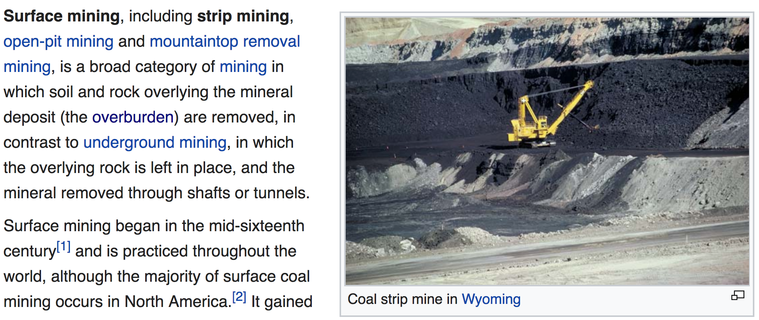
(Vector) Stripmining
Source: https://en.wikipedia.org/wiki/Surface_mining

Slide 42
Questions (II)
What if vector data is not stored in a strided fashion in memory? (irregular memory access to a vector)
Idea: Use indirection to combine/pack elements into vector registers
Called scatter/gather operations

Slide 43
Gather/Scatter Operations
Want to vectorize loops with indirect accesses:
for (i=0; i<N; i++)
A[i] = B[i] + C[D[i]]
Indexed load instruction (Gather)
LV vD, rD # Load indices in D vector
LVI vC, rC, vD # Load indirect from rC base
LV vB, rB # Load B vector
ADDV.D vA,vB,vC # Do add
SV vA, rA # Store result
Notes:
Gather example

Slide 44
Gather/Scatter Operations
Gather/scatter operations often implemented in hardware to handle sparse vectors (matrices)
Vector loads and stores use an index vector which is added to the base register to generate the addresses
Scatter example
Index Vector Data Vector (to Store) Stored Vector (in Memory)
0 3.14 Base+0 3.14
2 6.5 Base+1 X
6 71.2 Base+2 6.5
7 2.71 Base+3 X
Base+4 X
Base+5 X
Base+6 71.2
Base+7 2.71
Notes:
Scatter example

Slide 45
Conditional Operations in a Loop
What if some operations should not be executed on a vector (based on a dynamically-determined condition)?
loop: for (i=0; i<N; i++)
if (a[i] != 0) then b[i]=a[i]*b[i]
Idea: Masked operations
VMASK register is a bit mask determining which data element should not be acted upon
VLD V0 = A
VLD V1 = B
VMASK = (V0 != 0)
VMUL V1 = V0 * V1
VST B = V1
This is predicated execution. Execution is predicated on mask bit.

Slide 46
Another Example with Masking
for (i = 0; i < 64; ++i)
if (a[i] >= b[i])
c[i] = a[i]
else
c[i] = b[i]
Steps to execute the loop in SIMD code
1. Compare A, B to get
VMASK
2. Masked store of A into C
3. Complement VMASK
4. Masked store of B into C
A B VMASK
1 2 0
2 2 1
3 2 1
4 10 0
-5 -4 0
0 -3 1
6 5 1
-7 -8 1

Slide 47
Masked Vector Instructions
Simple Implementation
execute all N operations, turn off result writeback according to mask
Density-Time Implementation
scan mask vector and only execute elements with non-zero masks
M[7]=1
A[7]
B[7]
M[7]=1
M[6]=0
A[6]
B[6]
M[6]=0
A[7]
B[7]
M[5]=1
A[5]
B[5]
M[5]=1
M[4]=1
A[4]
B[4]
M[4]=1
M[3]=0
A[3]
B[3]
M[3]=0
C[5]
M[2]=0
C[4]
M[1]=1
M[2]=0
C[2]
M[0]=0
M[1]=1
C[1]
C[1]
Write data port
M[0]=0
C[0]
Which one is better?
Write Enable
Write data port
Tradeoffs?
Slide credit: Krste Asanovic

Slide 48
Some Issues
Stride and banking
As long as they are relatively prime to each other and there are enough banks to cover bank access latency, we can sustain 1 element/cycle throughput
Storage of a matrix
Row major: Consecutive elements in a row are laid out consecutively in memory
Column major: Consecutive elements in a column are laid out consecutively in memory
You need to change the stride when accessing a row versus column

Slide 49
Matrix Multiplication
A and B, both in row-major order
A: Load A₀ into vector register V₁
Each time, increment address by one to access the next column
Accesses have a stride of 1
B: Load B₀ into vector register V₂
Each time, increment address by 10
Accesses have a stride of 10
A_{4x6} B_{6x10} → C_{4x10}
Dot products of rows and columns of A and B
Different strides can lead to bank conflicts
How do we minimize them?

Slide 50
Minimizing Bank Conflicts
More banks
Better data layout to match the access pattern
Is this always possible?
Better mapping of address to bank
E.g., randomized mapping
Rau, “Pseudo-randomly interleaved memory,” ISCA 1991.

Slide 51
Array vs. Vector Processors, Revisited
Array vs. vector processor distinction is a “purist’s” distinction
Most “modern” SIMD processors are a combination of both
They exploit data parallelism in both time and space
GPUs are a prime example we will cover in a bit more detail

Slide 52
Recall: Array vs. Vector Processors
ARRAY PROCESSOR
VECTOR PROCESSOR
Instruction Stream
Same op @ same time
LD VR ← A[3:0]
ADD VR ← VR, 1
MUL VR ← VR, 2
ST A[3:0] ← VR
Different ops @ time
LD0
LD1
LD2
LD3
LD0
AD0
AD1
AD2
AD3
LD1
AD0
MU0
MU1
MU2
MU3
LD2
AD1
MU0
ST0
ST1
ST2
ST3
LD3
AD2
MU1
ST0
Different ops @ same space
AD3
MU2
ST1
MU3
ST2
Time
Same op @ space
ST3
Space
Space

Slide 53
Vector Instruction Execution
VADD A,B → C
Execution using one pipelined functional unit
Execution using four pipelined functional units
A[6]
B[6]
A[24]
B[24]
A[25]
B[25]
A[26]
B[26]
A[27]
B[27]
A[5]
B[5]
A[20]
B[20]
A[21]
B[21]
A[22]
B[22]
A[23]
B[23]
A[4]
B[4]
A[16]
B[16]
A[17]
B[17]
A[18]
B[18]
A[19]
B[19]
A[3]
B[3]
A[12]
B[12]
A[13]
B[13]
A[14]
B[14]
A[15]
B[15]
C[2]
C[8]
C[9]
C[10]
C[11]
C[1]
C[4]
C[5]
C[6]
C[7]
Time
Time
C[0]
C[0]
C[1]
C[2]
C[3]
Space
Slide credit: Krste Asanovic

Slide 54
Vector Unit Structure
Functional Unit
Partitioned
Vector
Registers
Elements 0, 4, 8, …
Elements 1, 5, 9, …
Elements 2, 6, 10, …
Elements 3, 7, 11, …
Lane
Memory Subsystem
Slide credit: Krste Asanovic

Slide 55
Vector Instruction Level Parallelism
Can overlap execution of multiple vector instructions
Example machine has 32 elements per vector register and 8 lanes
Completes 24 operations/cycle while issuing 1 vector instruction/cycle
Load Unit
Multiply Unit
Add Unit
load
mul
add
time
load
mul
add
Instruction issue
Slide credit: Krste Asanovic

Slide 56
We did not cover the following slides. They are for your preparation for the next lecture.

Slide 57
Automatic Code Vectorization
for (i=0; i < N; i++)
C[i] = A[i] + B[i];
Scalar Sequential Code
Vectorized Code
load
load
load
Iter. 1
load
load
load
Time
add
add
add
store
store
store
load
Iter. 1
Iter. 2
Iter. 2
load
Vector Instruction
add
Vectorization is a compile-time reordering of operation sequencing
⇒ requires extensive loop dependence analysis
store
Slide credit: Krste Asanovic

Slide 58
Vector/SIMD Processing Summary
Vector/SIMD machines are good at exploiting regular data-level parallelism
Same operation performed on many data elements
Improve performance, simplify design (no intra-vector dependencies)
Performance improvement limited by vectorizability of code
Scalar operations limit vector machine performance
Remember Amdahl’s Law
CRAY-1 was the fastest SCALAR machine at its time!
Many existing ISAs include (vector-like) SIMD operations
Intel MMX/SSEn/AVX, PowerPC AltiVec, ARM Advanced SIMD

Slide 59
SIMD Operations in Modern ISAs

Slide 60
SIMD ISA Extensions
Single Instruction Multiple Data (SIMD) extension instructions
Single instruction acts on multiple pieces of data at once
Common application: graphics
Perform short arithmetic operations (also called packed arithmetic)
For example: add four 8-bit numbers
Must modify ALU to eliminate carries between 8-bit values
60

Slide 61
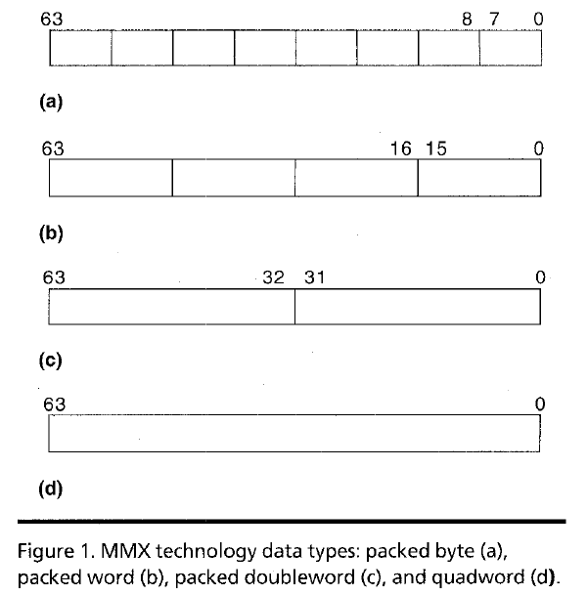
Intel Pentium MMX Operations
Idea: One instruction operates on multiple data elements simultaneously
À la array processing (yet much more limited)
Designed with multimedia (graphics) operations in mind
No VLEN register
Opcode determines data type:
8 8-bit bytes
4 16-bit words
2 32-bit doublewords
1 64-bit quadword
Stride is always equal to 1.
Peleg and Weiser, “MMX Technology
Extension to the Intel Architecture,”
IEEE Micro, 1996.

Slide 62
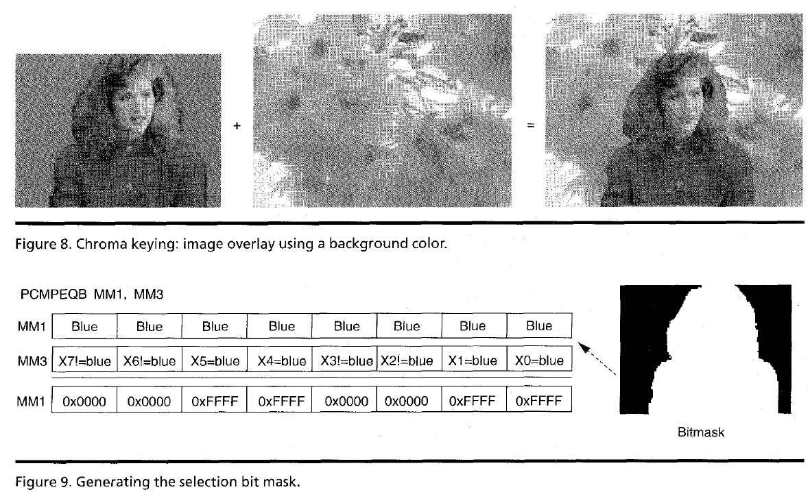
MMX Example: Image Overlaying (I)
Goal: Overlay the human in image 1 on top of the background in image 2
Peleg and Weiser, “MMX Technology Extension to the Intel Architecture,” IEEE Micro, 1996.

Slide 63
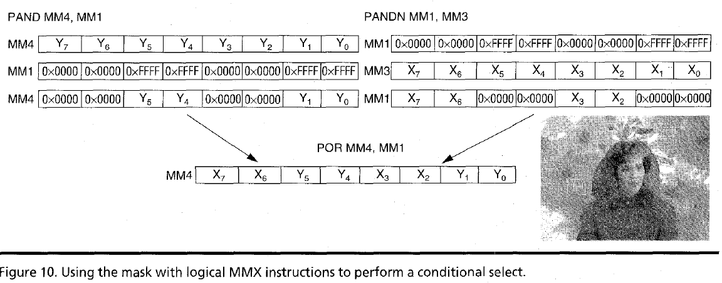
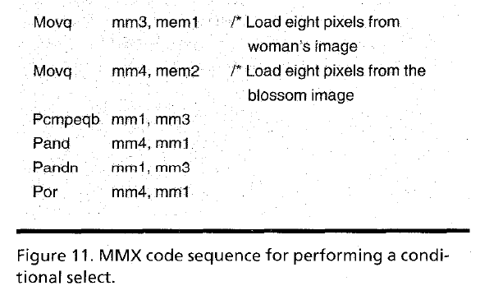
MMX Example: Image Overlaying (II)
Y = Blossom image
X = Woman’s image
Peleg and Weiser, “MMX Technology Extension to the Intel Architecture,” IEEE Micro, 1996.

Slide 64
Digital Design & Computer Arch. Lecture 19: SIMD Processors
Prof. Onur Mutlu
ETH Zürich
Spring 2020
7 May 2020

